Slide 1
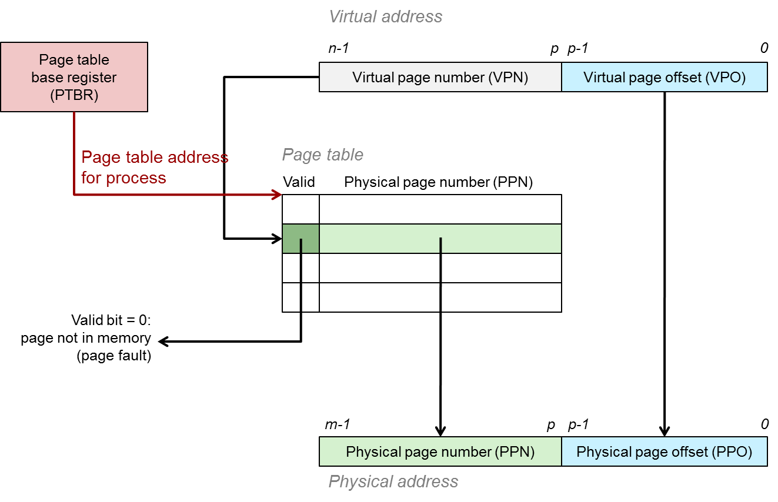
Memory Abstraction Recap: Virtual Memory

Slide 2
Lecture Outline
Motivation
The Basics
Features of Virtual Memory
Back to Our Example Program
A Real World Example: Intel Core i7 Address Translation
Summary

Slide 3
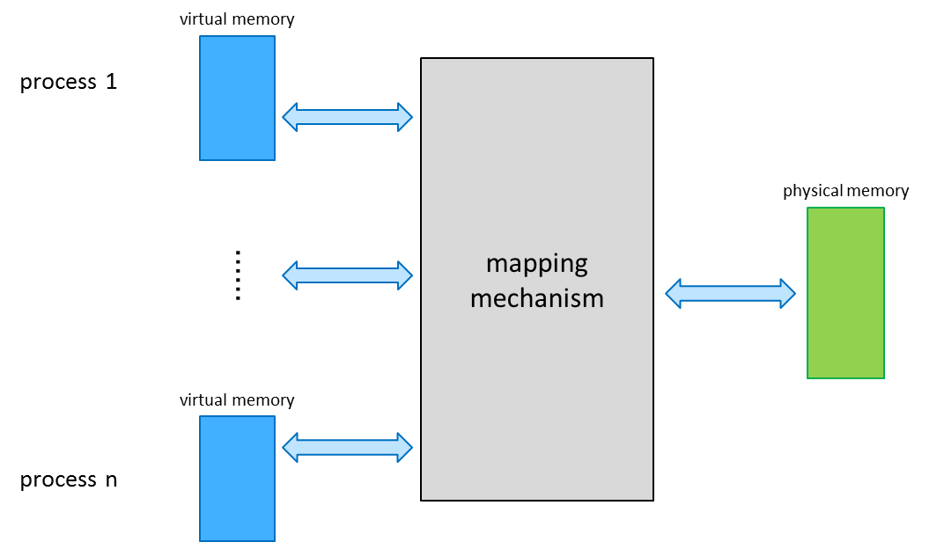
Motivation

Slide 4
Memory Up Until Now
Programs access data through memory addresses
ld x10, 16(x2) sd x11, 24(x2)
conceptually a very large array of bytes
ff…ffff
0:
1:
CPU
Address
2:
3:
4
4:
5:
6:
7:
8:
...
M-1:
Main memory
Data word
00…0000

Slide 5
Problem 1: How does everything fit?
virtual memory:
64-bit addresses,
16 exabytes
physical memory:
a few gigabytes
?
…and there are many processes!

Slide 6
Problem 2: Memory Management
physical main memory
process 1
process 2
process 3
…
process n
.text
.data
heap
stack
what goes where?
x

Slide 7
Problem 3: Protection
physical main memory
process i
process j
Problem 4: Sharing
process i
process j

Slide 8
Solution: Indirection
virtual memory
process 1
mapping
mechanism
physical memory
……
virtual memory
process n
Each process gets its own private memory space
Solves all our previous problems!

Slide 9
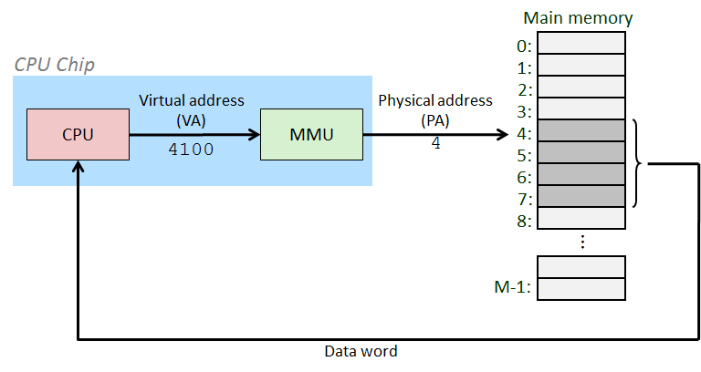
The Basics

Slide 10
The Basics
Virtual memory = Abstraction of physical memory, in particular
Virtual address (VA) = abstraction of physical address (PA)

Slide 11
The Basics
Implementation: indirection between VA and PA
mapping
mechanism
virtual address space
physical address space

Slide 12
The Basics
Implementation: indirection between VA and PA
physical page number (PPN)
10
9
8
7
6
5
4
3
2
1
0
virtual page number (VPN)
6
5
4
3
2
1
0
mapping
mechanism
VPN | PPN
6 | 0
5 | 9
4 | -
3 | -
2 | 5
1 | 1
0 | 2
virtual address space
physical address space

Slide 13
Translation of VA to PA
Implementation: indirection between VA and PA
physical page number (PPN)
10
9
8
7
6
5
4
3
2
1
0
virtual page number (VPN)
6
5
4
3
2
1
0
mapping
mechanism
VPN | PPN
6 | 0
5 | 9
4 | -
3 | -
2 | 5
1 | 1
0 | 2
virtual address space
physical address space

Slide 14
Translation of VA to PA
Translation of VA 0x233 to PA
page size = 0x100 (512 bytes)
VA 0x233 = virtual page: 2 (= 0x233/0x100)
2 (=0233 & 0xF00) virtual offset: 0x33 (= 0x233%0x100)
0x33 (=0x233 & 0x0FF)
VPN 2 maps to PPN 5 VPN (virtual page number)
PPN (physical page number)
PA = 0x533 physical page address: 0x500 physical offset: 0x33
physical page number (PPN)
10
9
8
7
6
5
4
3
2
1
0
virtual page number (VPN)
6
5
4
3
2
1
0
mapping
mechanism
VPN | PPN
6 | 0
5 | 9
4 | -
3 | -
2 | 5
1 | 1
0 | 2
virtual address space
physical address
space

Slide 15
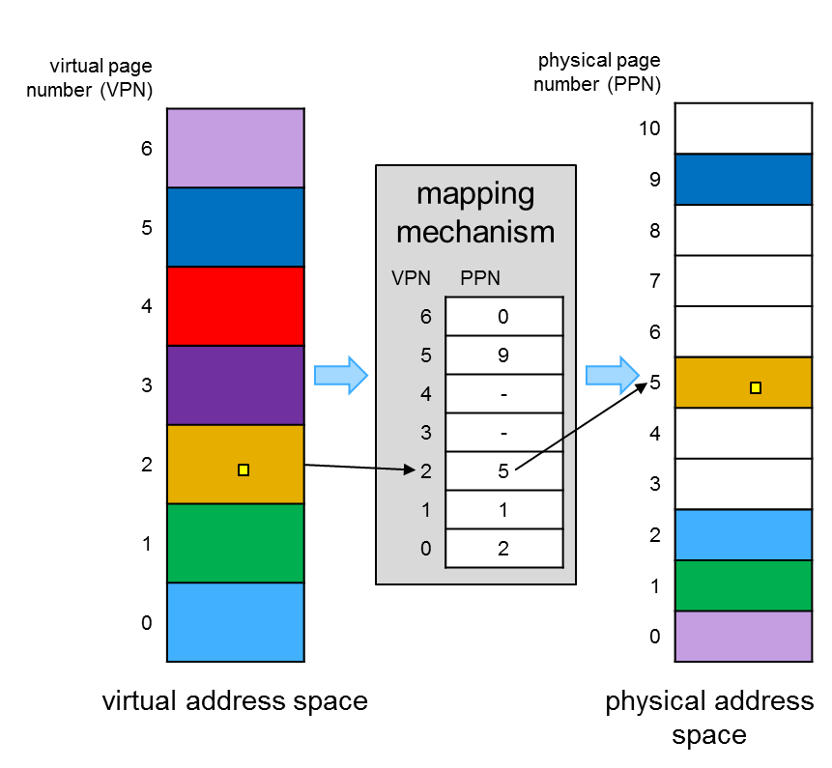
Translation of VA to PA
Given
page size (PS) (virtual page size == physical page size)
page table (PT) translation table VPN→PPN one entry in the table is called a page table entry (PTE)
Translation
PA = PT[ VA / PS ] + VA % PS
page
table

Slide 16
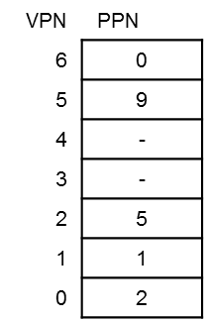
Memory Management Unit
Memory Management Unit (MMU)
hardware unit performing VA to PA translation
translation is time critical, has to be fast
The PT is stored in main memory, the MMU only holds a pointer to it
page table base register (PTBR)
on Intel architectures, the PTBR is named register CR3
MMU
physical page number (PPN)
10
9
8
7
6
5
4
3
2
1
0
MMU
PTBR = 0x800
physical address space

Slide 17
An Example Memory Hierarchy
CPU registers hold words retrieved from L1 cache.
Smaller,
faster,
and
costlier
(per byte)
storage
devices
L0:
registers
L1:
L1
cache (SRAM)
L1 cache holds cache lines retrieved from the L2 cache memory.
L2 cache holds cache lines retrieved from main memory.
L3 cache is typically shared across CPU cores
L2:
L2, L3 (shared)
cache (SRAM)
L3:
main memory
(DRAM)
Main memory holds disk
blocks retrieved from local
disks.
Larger,
slower,
and
cheaper
(per byte)
storage
devices
local secondary storage
(local disks)
Local disks hold files retrieved from disks on remote network servers.
L4:
remote secondary storage
(tapes, distributed file systems, Web servers)
L5:

Slide 18
Locality of Reference
Two kinds of locality
Temporal locality: recently referenced items are likely to be referenced in near future
Spatial locality: Items with nearby addresses tend to be referenced close together in time.
Locality example
Program data
Temporal: the variable sum
Spatial: variable a[i+1] accessed soon after a[i]
Instructions
Temporal: cycle through the for-loop repeatedly
Spatial: reference instructions in sequence
sum = 0;
for (i = 0; i < n; i++)
sum += a[i];
return sum;

Slide 19
Locality Makes Caching Effective
Cache
Smaller, faster storage device that acts as a staging area
… for a subset of the data in a larger, slower device
Caching and the memory hierarchy
Storage device at level k is a cache for level k+1
Registers as cache of L1/L2 cache and main memory
Main memory as a cache for the disk
Disk as a cache of files from remote storage
Locality of access is the key
Most accesses satisfied by first few (faster) levels
Very few accesses go to the last few (slower) levels

Slide 20
Caching in a Memory Hierarchy
Level k:
Smaller, faster, more expensive
device at level k caches a subset
of the blocks from level k+1
4
9
10
3
Data copied between levels in block-sized transfer units
Level k+1:
0
1
2
3
4
Larger, slower, cheaper storage
device at level k+1 is partitioned
into blocks.
4
5
6
7
8
9
10
10
11
12
13
14
15

Slide 21
Cache Block Sizes
Fixed vs. variable size
Fixed-sized blocks are easier to manage (common case)
Variable-sized blocks make more efficient use of storage
Block size
Depends on access times at the level k+1 device
Larger block sizes further down in the hierarchy
E.g., disk seek times are slow, so disk pages are larger
Examples
CPU registers: 4-byte (32bit) or 8 byte (64bit CPU) words
L1/L2 cache: 32-byte (32bit) or 64-byte (64-bit CPU) blocks
Main memory: 4 KB pages (you can set up 2MB/1GB pages)
Disk: entire files

Slide 22
Cache Hit and Miss
Cache hit
Program accesses a block available in the cache
Satisfy directly from cache
E.g., request for “10”
Cache miss
Program accesses a block not available in the cache
Bring item into the cache
E.g., request for “13”
Where to place the item?
Which item to evict?
Level k:
8
4
9
14
3
10
Level k+1:
0
1
2
3
4
4
5
6
7
8
9
10
10
11
12
13
14
15

Slide 23
Three Kinds of Cache Misses
Cold (compulsory) miss
Cold misses occur because the block hasn’t been accessed before
E.g., first time a segment of code is executed
E.g., first time a particular array is referenced
Capacity miss
Set of active cache blocks (the “working set”) is larger than cache
E.g., manipulating a 1200-byte array within a 1000-byte cache
Conflict miss
Some caches limit the locations where a block can be stored
E.g., block i must be placed in cache location (i mod 4)
Conflicts occur when multiple blocks map to the same location(s)
E.g., referencing blocks 0, 8, 0, 8, 0, 8, ... would miss every time

Slide 24
Cache Replacement
Evicting a block from the cache
New block must be brought into the cache
Must choose a “victim” to evict
Optimal eviction policy
Evict a block that is never accessed again
Evict the block accessed the furthest in the future
Impossible to implement without knowledge of the future
Using the past to predict the future
Evict the “least recently used” (LRU) block
Assuming it is not likely to be used again soon
But, LRU is often expensive to implement
Need to keep track of access times
So, simpler approximations of LRU are used

Slide 25
Who Manages the Cache?
Registers
Cache of L1/L2/L3 cache and main memory
Managed explicitly by the compiler
By determining which data are brought in and out of registers
Using relatively sophisticated code-analysis techniques
L1/L2/L3 cache
Cache of main memory
Managed by the hardware
Using relatively simple mechanisms (e.g., “i mod 4”)
Main memory
Cache of the disk
Managed (in modern times) by the operating system
Using relatively sophisticated mechanisms (e.g., LRU-like)
Since reading from disk is extremely time consuming

Slide 26
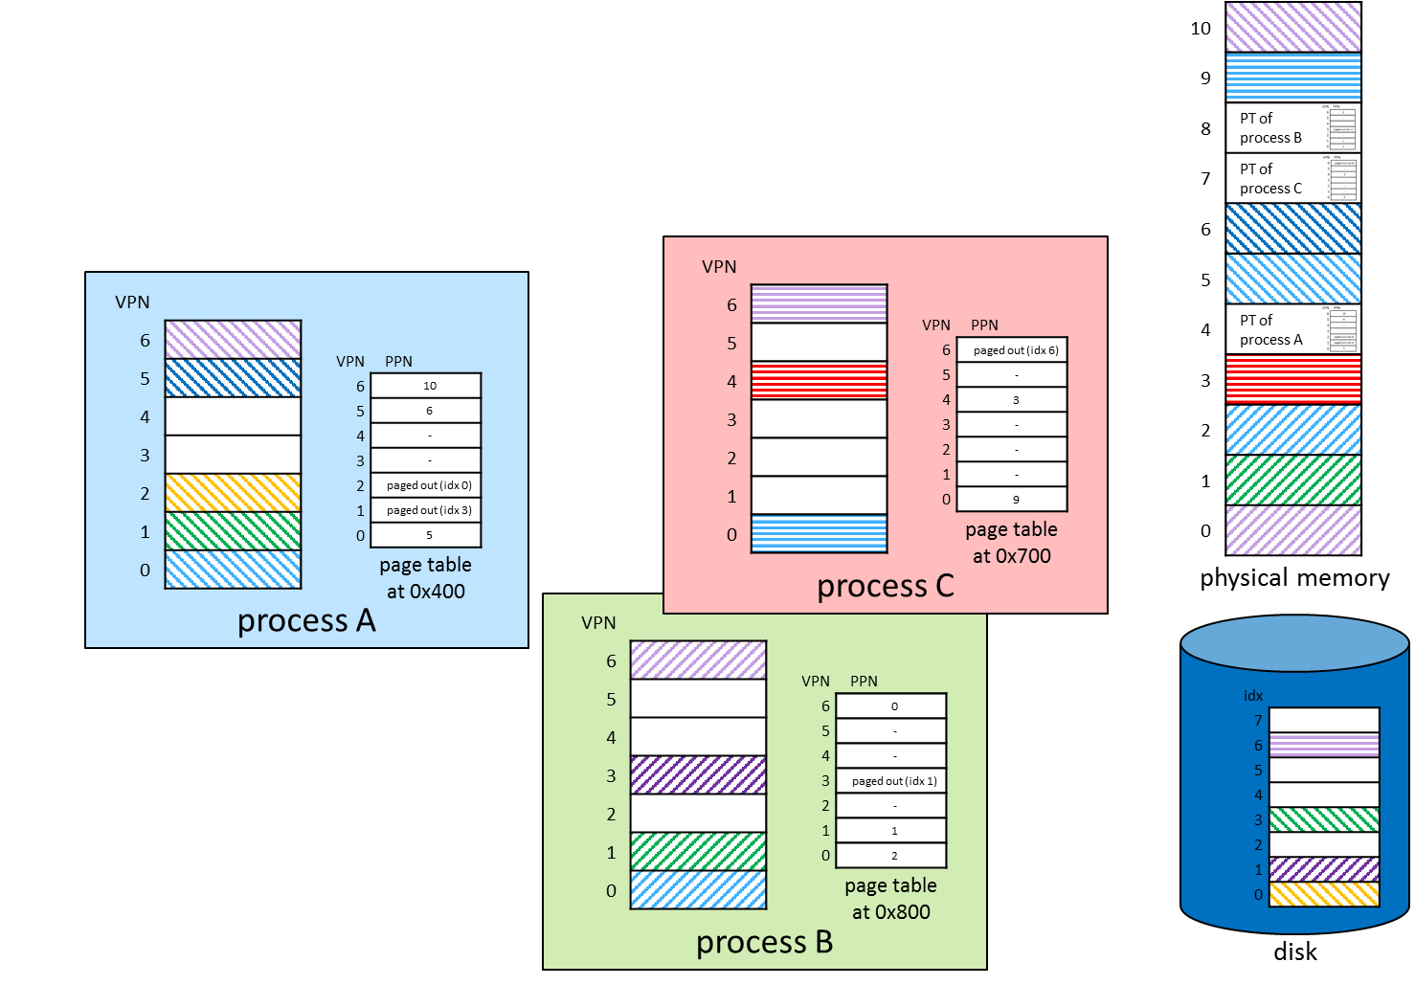
Features of Virtual Memory

Slide 27
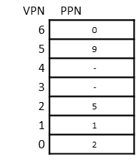

Address Space Isolation
physical page number (PPN)
10
9
8 | PT of process B
7
6
5
4 | PT of process A
3
2
1
0
Each process has its own address space → each process has its own page table
process A
VPN
6
5
4
3
2
1
0
VPN | PPN
6 | 10
5 | -
4 | 6
3 | -
2 | 7
1 | -
0 | 3
MMU
PTBR = PT of running process
page table
at 0x400
process B
VPN
6
5
4
3
2
1
0
VPN | PPN
6 | 0
5 | 9
4 | -
3 | -
2 | 5
1 | 1
0 | 2
physical address
space
page table
at 0x800

Slide 28
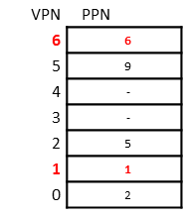
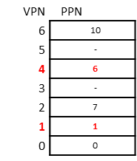
Shared Memory
physical page number (PPN)
10
9
8 | PT of process B
7
6
5
4 | PT of process A
3
2
1
0
Memory sharing between processes → map same page into address space of more than 1 process → VA does not have to be identical
process A
VPN
6
5
4
3
2
1
0
VPN | PPN
6 | 10
5 | -
4 | 6
3 | -
2 | 7
1 | 1
0 | 0
page table
at 0x400
process B
VPN
6
5
4
3
2
1
0
VPN | PPN
6 | 6
5 | 9
4 | -
3 | -
2 | 5
1 | 1
0 | 2
physical address
space
page table
at 0x800

Slide 29


Decoupling of Virtual from Physical Address Space
Run several processes with a large virtual address space on a much smaller physical memory
10
9
8 | PT of process B
7 | PT of process C
6
5
4 | PT of process A
3
2
1
0
process C
VPN
6
5
4
3
2
1
0
process A
VPN
6
5
4
3
2
1
0
VPN | PPN
6 | -
5 | -
4 | 3
3 | -
2 | -
1 | -
0 | 9
VPN | PPN
6 | 10
5 | -
4 | -
3 | -
2 | -
1 | -
0 | 5
page table
at 0x700
page table
at 0x400
process B
VPN
6
5
4
3
2
1
0
each process “sees”
7*0x100 = 0x700 bytes (7 pages) of virtual memory 3 processes “see” 0x1500
bytes (21 pages) of virtual memory
VPN | PPN
6 | 0
5 | -
4 | -
3 | -
2 | -
1 | 1
0 | 2
physical memory
11*0x100 = 0xB00 (11 pages)
page table
at 0x800

Slide 30
Decoupling of Virtual from Physical Address Space
64-bit process on much smaller physical memory (PS=4KB)
VPN
4503599627370495
4503599627370494
4503599627370493
…
64-bit process
physical machine
PPN
1048575
1048574
1048573
…
VPN | PPN
4503599627370495 | …
4503599627370494 | …
4503599627370493 | …
2 | …
1 | …
0 | …
Lots of engineering problems:
how big is the page table?
multi-level page tables
security
isolation
sharing
avoid duplication
lazy copy / copy on write (COW)
…
2
1
0
…
2
1
0
virtual memory space 2⁶⁴ b = 16 EB = 4’503’599’627’370’496 pages
physical memory 4GB = 1’048’576 pages

Slide 31
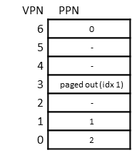
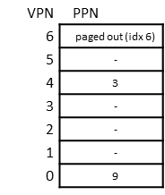
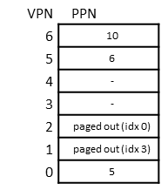
Physical Memory as a Cache
10
9
8 | PT of process B
7 | PT of process C
6
5
4 | PT of process A
3
2
1
0
Use the disk for swapping (“on-demand paging”)
process C
VPN
6
5
4
3
2
1
0
process A
VPN
6
5
4
3
2
1
0
VPN | PPN
6 | paged out (idx 6)
5 | -
4 | 3
3 | -
2 | -
1 | -
0 | 9
VPN | PPN
6 | 10
5 | 6
4 | -
3 | -
2 | paged out (idx 0)
1 | paged out (idx 3)
0 | 5
page table
at 0x700
page table
at 0x400
physical memory
process B
VPN
6
5
4
3
2
1
0
VPN | PPN
6 | 0
5 | -
4 | -
3 | paged out (idx 1)
2 | -
1 | 1
0 | 2
idx
7
6
5
4
3
2
1
0
Lots of engineering problems:
what happens when accessing address 0x233 in process A?
which page to replace when physical memory is full?
…
page table
at 0x800
disk

Slide 32

Memory Access Permissions
Define access permissions for each page to prevent from bugs / attacks
physical page number (PPN)
10
9
8
7
6
5
4 | PT of process A
3
2
1
0
process A
VPN
6
5
4
3
2
1
0
VPN | PPN | Permissions
6 | 10 | S R W
5 | -
4 | 6 | R W
3 | -
2 | 7 | R
1 | -
0 | 3 | R X
CPU core
MMU
PTBR = 0x400
2 | 7 | R
Exception
addl $1, %rax
mov %rax, (%rdx)
…
CPU mode
physical address
space

Slide 33
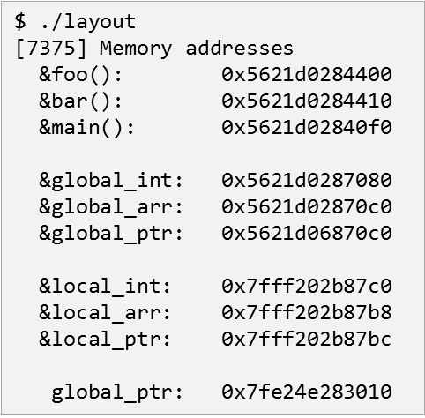
Back to Our Example Program

Slide 34
Motivating Example
…
//
// create child processes
// each process has a different 'delay' value
//
while (nproc > 1) {
if (fork() == 0) break;
nproc--;
}
delay = nproc;
…
//
// endless loop increasing global_int / shared_int
//
while (1) {
…
// increase variables
global_int++;
sem_wait(&shared->m);
shared->shared_int++;
sem_post(&shared->m);
sleep(delay); }
return EXIT_SUCCESS;
}
Where do functions & variables go?
…
#define N 1024*1024
int global_int = 0; …
struct __shared {
sem_t m;
int shared_int;
} *shared;
…
int main(int argc, char *argv[])
{
…
//
// create & initialize shared memory area
//
shared = (struct __shared*)mmap(NULL, sizeof(struct __shared), PROT_READ|PROT_WRITE, MAP_ANONYMOUS|MAP_SHARED, 0, 0);
if (shared == MAP_FAILED) {
perror("Cannot map shared memory");
return EXIT_FAILURE;
}
sem_init(&shared->m, 1, 1);
shared->shared_int = 0; …
layout.c

Slide 35
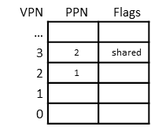
Motivating Example
physical address
space
10
9
8
7
6
5
4 | PT of process A
3
2
1
0
process A
VPN
… | …
3 | { m, shared_int }
2 | global_int shared
1
0
VPN | PPN | Flags
…
3 | 2 | shared
2 | 1
1
0
page table
at 0x400
…
int global_int = 0;
struct __shared {
sem_t m;
int shared_int;
} *shared;
…
int main(int argc, char *argv[]) { …
// create & initialize shared memory area
shared = (struct __shared*)mmap(NULL, sizeof(struct __shared), PROT_READ|PROT_WRITE, MAP_ANONYMOUS|MAP_SHARED, 0, 0);
…

Slide 36

Motivating Example
physical address
space
10
9
8
7
6
5 | PT of process B
4 | PT of process A
3
2
1
0
process A
process B
VPN
… | …
3 | { m, shared_int }
2 | global_int shared
1
0
VPN
… | …
3 | { m, shared_int }
2 | global_int shared
1
0
VPN | PPN | Flags
…
3 | 2 | shared
2 | 1
1
0
VPN | PPN | Flags
…
3 | 2 | shared
2 | 7
1
0
page table
at 0x400
page table
at 0x500
…
while (nproc > 1) {
if (fork() == 0) break;
nproc--;
} …

Slide 37
Motivating Example
physical address
space
… [16074] global_int = mem[0x55d2946ed0e0] = 0; shared_int = mem[0x7f8e5cbdf020] = 0
[16075] global_int = mem[0x55d2946ed0e0] = 0; shared_int = mem[0x7f8e5cbdf020] = 1
[16074] global_int = mem[0x55d2946ed0e0] = 1; shared_int = mem[0x7f8e5cbdf020] = 2
[16074] global_int = mem[0x55d2946ed0e0] = 2; shared_int = mem[0x7f8e5cbdf020] = 3
[16075] global_int = mem[0x55d2946ed0e0] = 1; shared_int = mem[0x7f8e5cbdf020] = 4
[16074] global_int = mem[0x55d2946ed0e0] = 3; shared_int = mem[0x7f8e5cbdf020] = 5
[16075] global_int = mem[0x55d2946ed0e0] = 2; shared_int = mem[0x7f8e5cbdf020] = 6
[16074] global_int = mem[0x55d2946ed0e0] = 4; shared_int = mem[0x7f8e5cbdf020] = 7
…
10
9
8
7
6
5 | PT of process B
4 | PT of process A
3
2
1
0
process A
process B
VPN
… | …
3 | { m, shared_int }
2 | global_int shared
1
0
VPN
… | …
3 | { m, shared_int }
2 | global_int shared
1
0
VPN | PPN | Flags
…
3 | 2 | shared
2 | 1
1
0
VPN | PPN | Flags
…
3 | 2 | shared
2 | 7
1
0
page table
at 0x400
page table
at 0x500
…
while (1) {
…
// increase variables;
global_int++;
sem_wait(&shared->m);
shared->shared_int++;
sem_post(&shared->m); sleep(delay); }
global_int | shared_int | global_int
1 | 1
 | 2 | 1
2 | 3
3 | 4
 | 5 | 2
4 | 6
 | 7 | 3
…
while (1) {
…
// increase variables;
global_int++;
sem_wait(&shared->m);
shared->shared_int++;
sem_post(&shared->m); sleep(delay); }

Slide 38
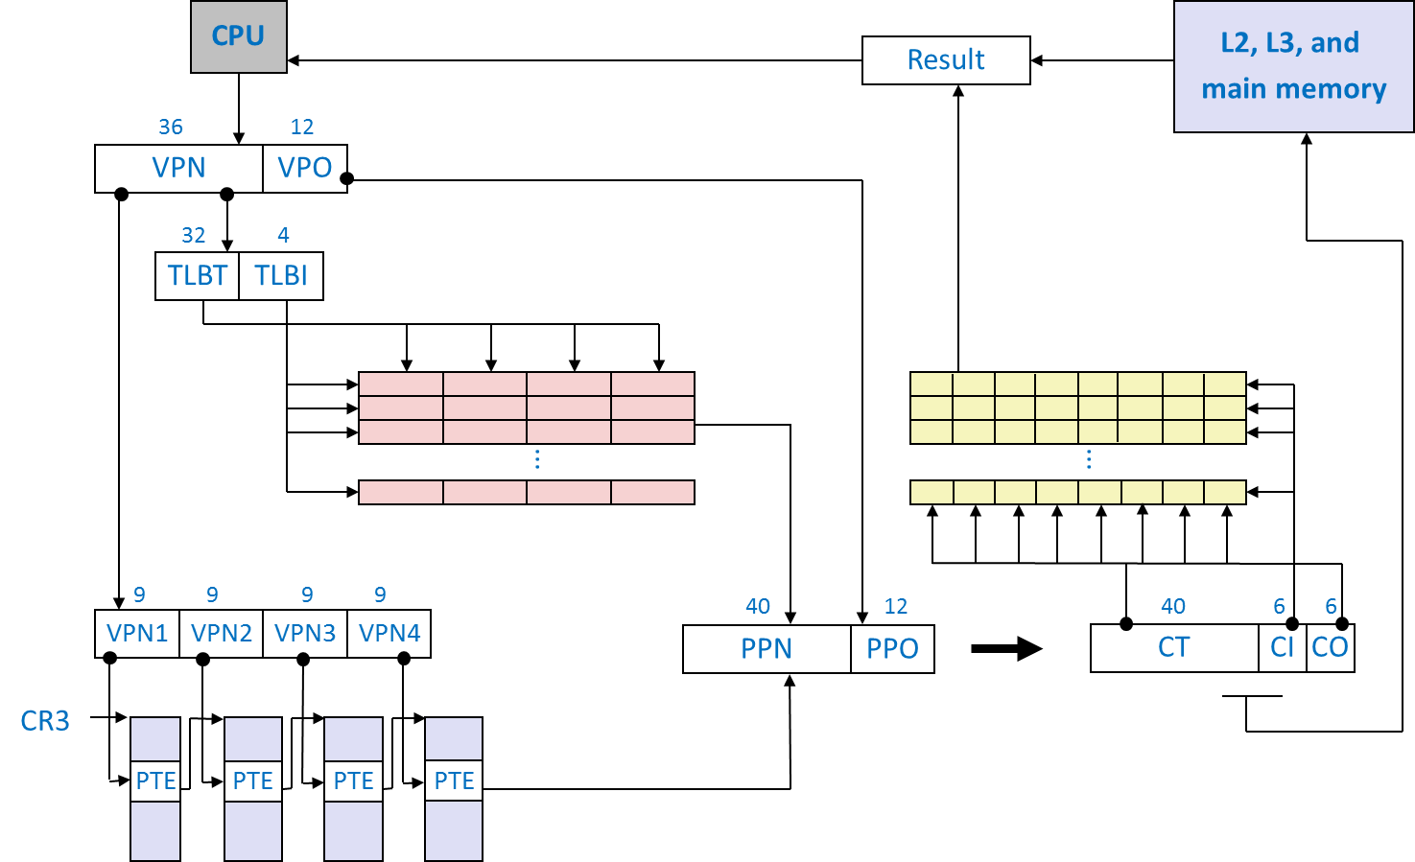
A Real World Example: Intel Core i7 Address Translation

Slide 39
Intel Core i7 Memory System
Processor package
Core x4
Registers
Instruction
fetch
MMU
(addr translation)
L1 d-cache
32 KB, 8-way
L1 i-cache
32 KB, 8-way
L1 d-TLB
64 entries, 4-way
L1 i-TLB
128 entries, 4-way
L2 unified cache
256 KB, 8-way
L2 unified TLB
512 entries, 4-way
To other
cores
QuickPath interconnect
4 links @ 25.6 GB/s each
To I/O
bridge
L3 unified cache
8 MB, 16-way
(shared by all cores)
DDR3 Memory controller
3 x 64 bit @ 10.66 GB/s
32 GB/s total (shared by all cores)
Main memory

Slide 40
End-to-end Core i7 Address Translation
CPU
32/64
L2, L3, and
main memory
Result
48-bit virtual address (VA)
36
12
VPN
VPO
L1
hit
L1
miss
32
4
TLBT
TLBI
L1 d-cache
(64 sets, 8 lines/set)
TLB
hit
TLB
miss
...
...
L1 TLB (16 sets, 4 entries/set)
9
9
9
9
40
12
40
6
6
VPN1
VPN2
VPN3
VPN4
PPN
PPO
CT (tag)
CI
CO
CR3
Physical
address
(PA)
PTE
PTE
PTE
PTE
Index of the set
offset
inside a cacheline
cacheline size=64B
Page tables
Why these numbers?

Slide 41
Core i7 Page Table Translation (VPN:36bits, PPN:40bits)
9
9
9
9
12
Virtual
address
VPN 1
VPN 2
VPN 3
VPN 4
VPO
L1 PT
Page global
directory
L2 PT
Page upper
directory
L3 PT
Page middle
directory
L4 PT
Page
table
Offset into
physical and
virtual page
40
40
40
40
CR3
/
/
/
/
Physical
address
of L1 PT
/
12
L1 PTE
L2 PTE
L3 PTE
L4 PTE
Physical
address
of page
512 GB
region
per entry
1 GB
region
per entry
2 MB
region
per entry
4 KB
region
per entry
40
/
40
12
Physical
address
PPN
PPO

Slide 42
Core i7 Level 1-3 Page Table Entries
63
62
52
51
(40bit)
12
11
9
8
7
6
5
4
3
2
1
0
XD
Unused
Page table physical base address
Unused
G
PS
A
CD
WT
U/S
R/W
P=1
Available for OS (page table location on disk)
P=0
Each entry references a 4K child page table
P: Child page table present in physical memory (1) or not (0).
R/W: Read-only or read-write access access permission for all reachable pages.
U/S: user or supervisor (kernel) mode access permission for all reachable pages.
WT: Write-through or write-back cache policy for the child page table.
CD: Caching disabled or enabled for the child page table.
A: Reference bit (set by MMU on reads and writes, cleared by software).
PS: Page size either 4 KB or 4 MB (defined for Level 1 PTEs only).
G: Global page (don’t evict from TLB on task switch)
Page table physical base address: 40 most significant bits of physical page table address (forces page tables to be 4KB aligned)

Slide 43
Core i7 Level 4 Page Table Entries
63
62
52
51
(40bit)
12
11
9
8
7
6
5
4
3
2
1
0
XD
Unused
Page physical base address
Unused
G
D
A
CD
WT
U/S
R/W
P=1
Available for OS (page location on disk)
P=0
Each entry references a 4K child page
P: Child page is present in memory (1) or not (0)
R/W: Read-only or read-write access permission for child page
U/S: User or supervisor mode access
WT: Write-through or write-back cache policy for this page
CD: Cache disabled (1) or enabled (0)
A: Reference bit (set by MMU on reads and writes, cleared by software)
D: Dirty bit (set by MMU on writes, cleared by software)
G: Global page (don’t evict from TLB on task switch) – e.g., kernel code
Page physical base address: 40 most significant bits of physical page address (forces pages to be 4KB aligned)

Slide 44
Current x86_64 Address Translation
Canonical address space
currently, only 48 of 64 bit are used
full 64-bit address space (16EB = 16 million terabytes) today still “too big”
48-bit implementation provides 256 TB of usable virtual address space
top 16 bits are sign-extended from bit 47, forming two “canonical halves”
FFFFFFFF FFFFFFFF
FFFF.... ........
kernel address space
FFFF8000 00000000
00007FFF FFFFFFFF
0000.... ........
user address space
00000000 00000000

Slide 45
Summary
Summary
-------------
-------------
-------------
-------------
-------------
-----

Slide 46
Virtual Memory
Virtual memory = abstraction of physical memory
Maintained with a per-process address translation mechanism
Implementation through a combination of hardware (memory management unit) and page table data structure maintained by the OS
Enables
Private memory
Shared memory
Fitting multiple processes with large address spaces into one physical address space
Paging/swapping
Fine-grained access permissions

